Slide 1


Slide 2
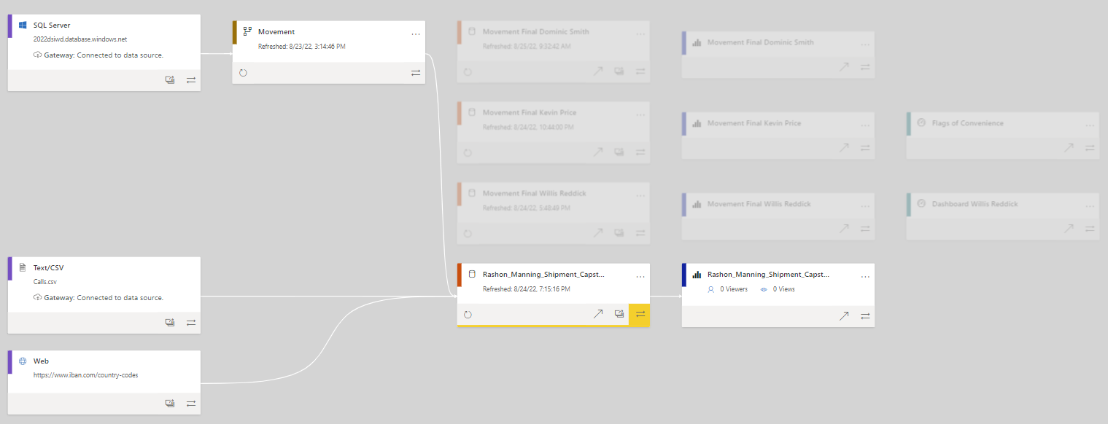
Notes:
Here you can see the steps I took to import the data into Power BI: 1). Imported the data from SQL server using data flow; Next, uploaded the revised Calls csv file; Lastly, imported a table directly from the web

Slide 3
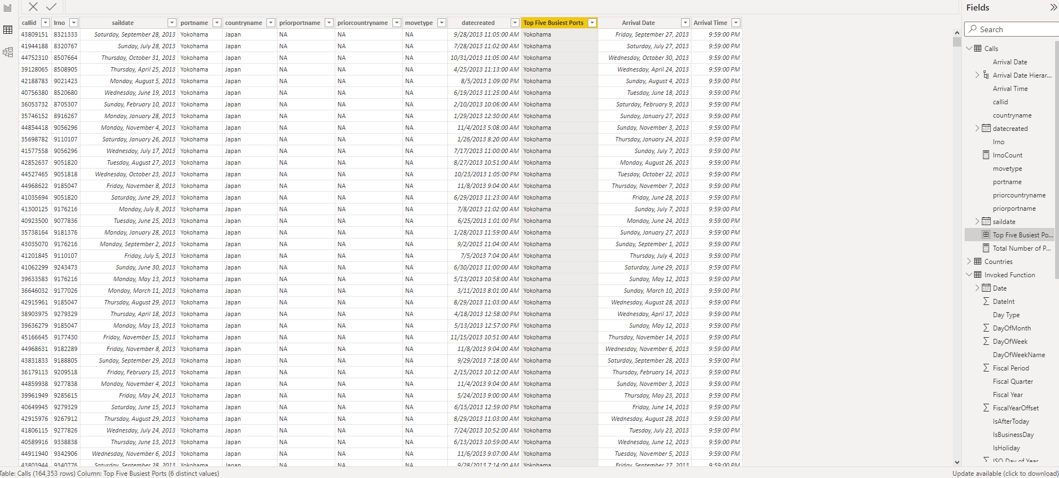

Slide 4
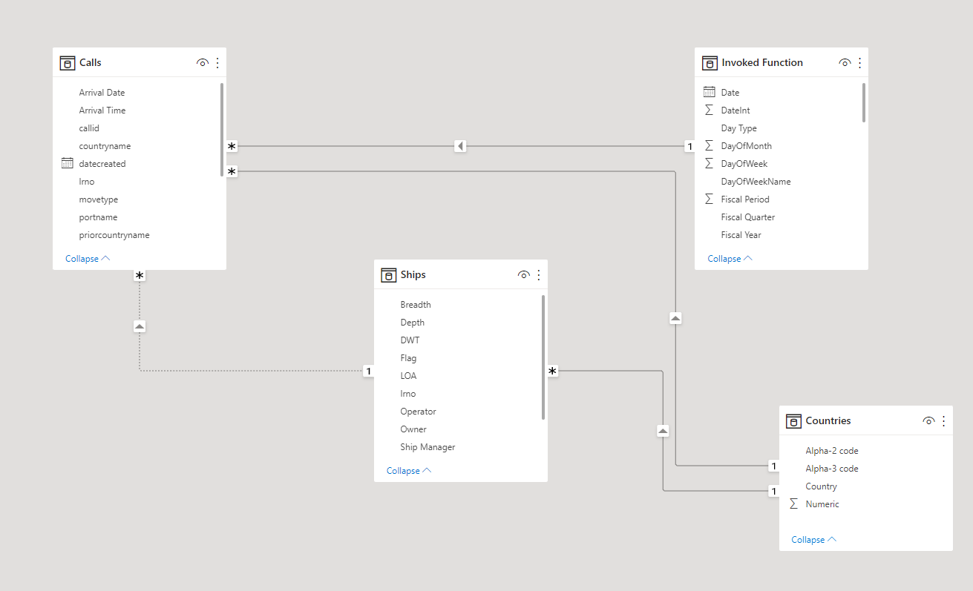

Slide 5

EFFECTIVE SHIPMENT SCHEDULING
Rashon Manning

Slide 6

OVERVIEW
Introduction
Problem
Hypothesis
Data/Findings
Summary
Notes:
After reviewing the dataset, I was able to form a hypothesis where having the ship dock on a certain day of the week would decrease turnaround time; Furthermore, scheduling the ship to sail at a certain time of the year would minimize the amount of cargo lost out at sea. Now, let’s explore the data more in-depth

Slide 7




ABOUT ME
About
Notes:
Hi! My name is Rashon Manning, and I was born and raised in a small town called Cordele, Georgia (fun fact: Cordele is known as the Watermelon Capital of the World). Immediately after high school, I joined the US Army where I served for over eight years (five in upstate NY and three in Germany) with two tours to Afghanistan. After my time in the Army, I attended Mercer University where I obtained both by undergrad degree and my MBA. During my undergrad, I had the opportunity to study abroad in Hong Kong. I was recruited to FirstBank in Lakewood, Colorado where I spent the last three years as a Banking Officer where I did everything from presenting to c-suite level executives to lending. I recently moved to Texas a couple of months ago with the intention of attending Divergence Academy in order to land a job as a Data Scientist at a financial institution, insurance company, or healthcare industry.
I currently work as a consultant at MOVEMENT Consultants where we use data to identify trends and make suggestions. I was hired to identify these problems by freight companies.

Slide 8

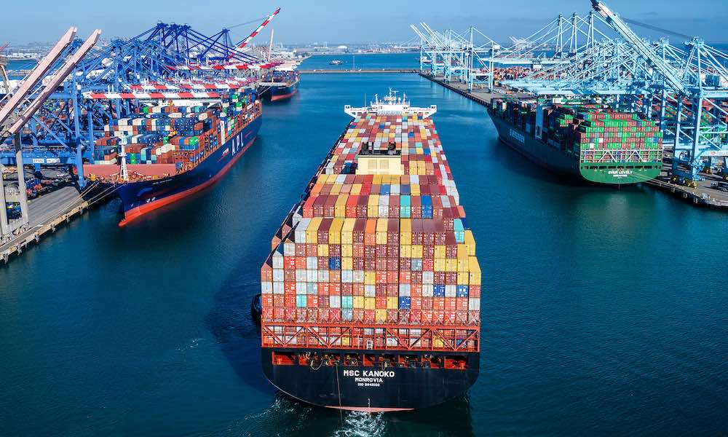
PROBLEM
Problem
Increased turnaround time
Businesses have noticed an increased turn around time when attempting to dock at the five busiest ports
Lost cargo
Businesses have noticed an unexplained significant increased in loss cargo when traversing through the Pacific Ocean
Notes:
First problem: Companies were seeing increased turnaround times at the five busiest ports.

Slide 9

HYPOTHESIS
Docking at specific time of week/year
Decreased turnaround time and less lost cargo
Notes:
After reviewing the dataset, I was able to form a hypothesis where having the ship dock on a certain day of the week would decrease turnaround time; Furthermore, scheduling the ship to sail at a certain time of the year would minimize the amount of cargo lost out at sea. Now, let’s explore the data more in-depth

Slide 10
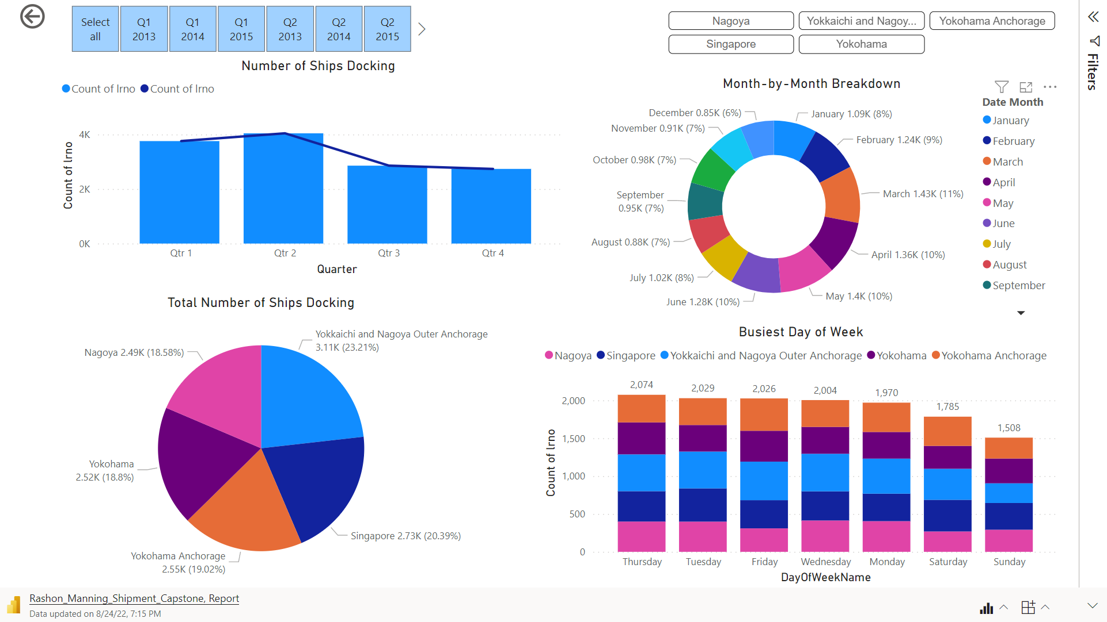
Notes:
I will now direct your attention to the pie chart in the lower left-hand corner. This pie chart represents the Total Number of Ships docking at the five busiest ports. As you can see, Yokkauchi and Nagoya leds the port with 23% followed by Singapore and then Yokohama. We will be referencing these ports going forward with our analysis.
On the bottom right-hand you will see a stacked column chart broken down by ports. This column chart reflects the days of the week these ships docked at the different ports. According to the data, it appears (if all factor remain the same i.e. employees, weather, equipment used, etc) the best day to dock would be on Sunday for Yokkaichi, Singapore, and Yokohama Anchorage, while Saturday would be best for Nagoya and Yokohama.
The worse days for the ports are as follows: Wednesday for Nagoya, Friday for Yokkaichi and Yokohama Anchorage, Tuesday for Singapore, and Thursday for Yokohama

Slide 11
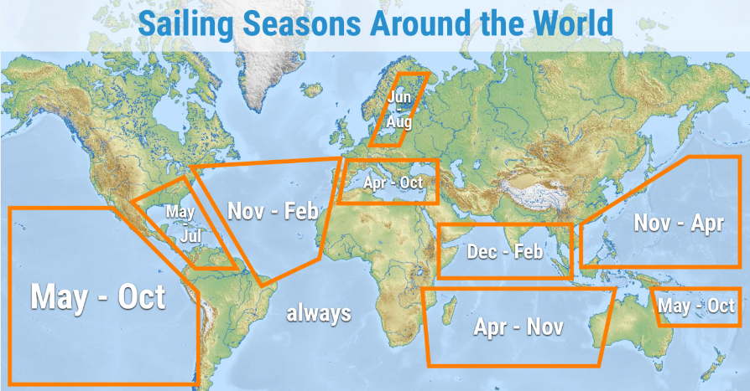
Notes:
Next, we will address the lost cargo. The Pacific Ocean, the largest ocean on Earth, stretches from the western cost of the Continental North and South America to the eastern coast of Asia and Australia. Since most of the ports are in eastern Asia, Japan and Singapore to be exact, we will be focused primarily on this region. The image shows the peak sailing season of November through April for this region. Hurricanes (officially called tropical cyclones) season officially starts in late June through November.

Slide 12

Notes:
As you can see in the top left-hand corner, Q1 and Q2 have significant ship activity at the five ports with the activity tapering off around the third and fourth quarter. As we drill down to the next layer, the data seems to correlate with the peak of tropical cyclone season which heats up in August through mid-October. Our suggestion is to avoid traversing the Pacific Ocean during these peak times in order to minimize the lost of cargo. (DRILL DOWN TO DAYS OF THE MONTH)

Slide 13

SUMMARY
Plan to dock on specific days of the week
Avoid sailing across the Pacific Ocean during peak tropical cyclone season
Dock at the beginning of the month instead of the end
summary
Notes:
In summary, the data

Slide 14

Thank You
Rashon Manning
555-333-1111
Rashon.Manning@Divergence.One

